Slide 1
PROJECT NAME
BLOOD BANK
MANAGEMENT SYSTEM

Slide 2
EXISTING SYSTEM :
The operation of the blood bank still now is maintained in manual system .
The operation is tedious, time consuming and space consuming.
It creates room for errors as the data is entered manually by the person.
It includes the risk of the documents being lost over years and maintenance of the records is difficult.
The data recorded during testing or while acquiring the details of different aspects of blood bank management system is not so accurate and precise.
Maintaining the stock of blood and the daily transactions without computerisation also poses a challenge

Slide 3
PROBLEM STATEMENT :
Scarcity of rare blood group.
Unavailability of blood during emergency.
Less awareness among people about blood donation and blood transfusion.
Deaths due to lack of blood during operations.
This project aims to make all the procedures automated so that it can be more fast and accurate.
This project is a software to manage all these cumbersome jobs.

Slide 4
project details :
The project blood bank management system is a project that is designed for the blood bank to gather blood from various sources and distribute it to the needy people who have high requirement for it.
The software is designed to handle the daily transactions of the blood bank and search the details when required.
It also helps to register the details of donors as well as blood collection details.
This software application can suit the needs of all the blood bank requirement in the course of future.

Slide 5
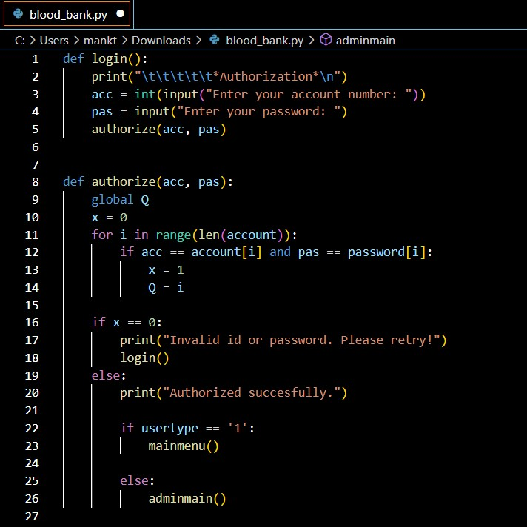
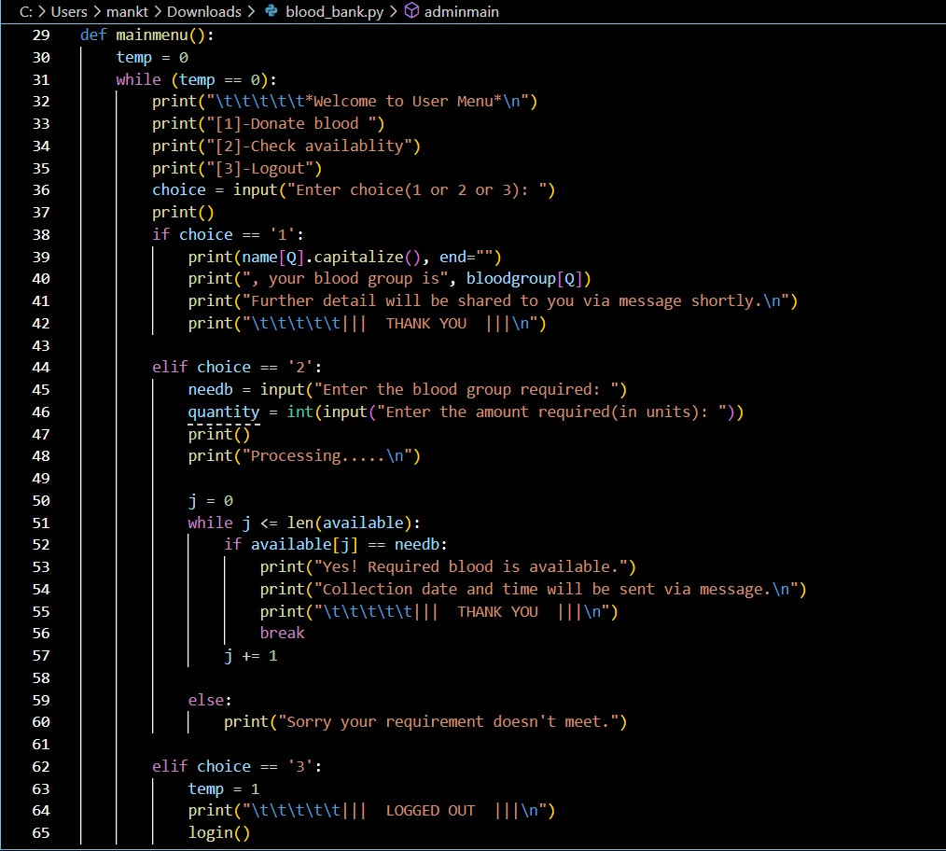
Source code :

Slide 6
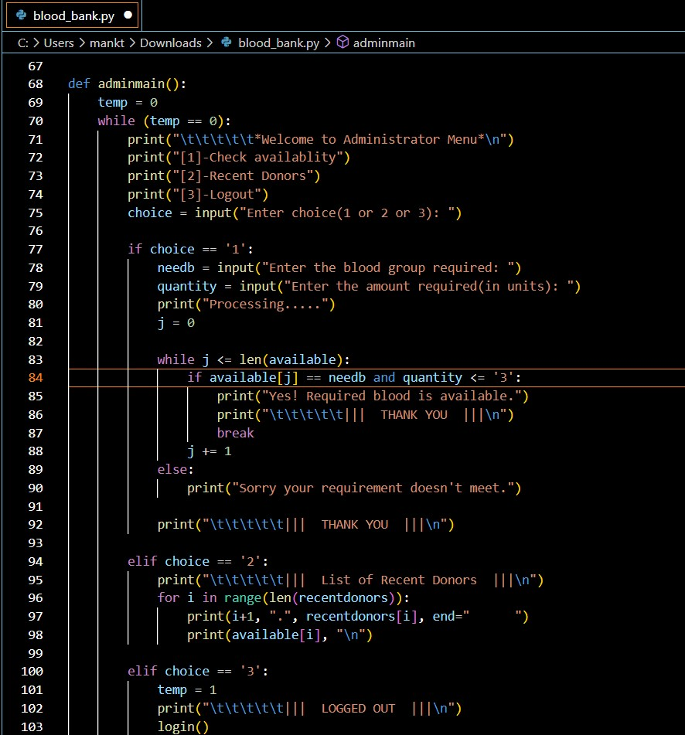
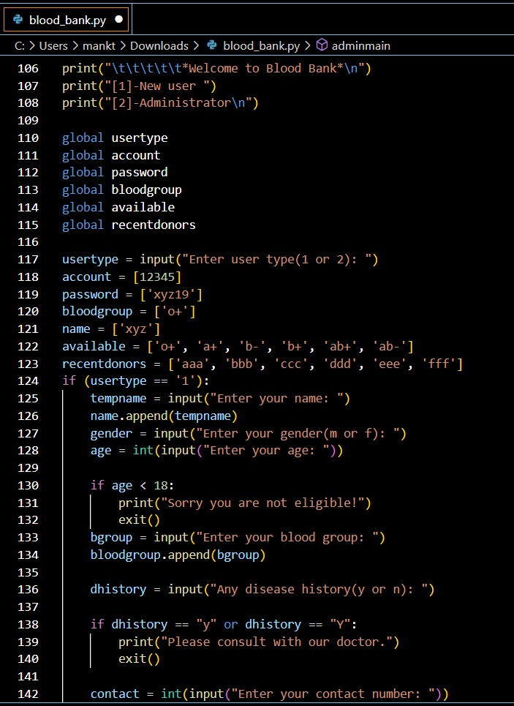

Slide 7
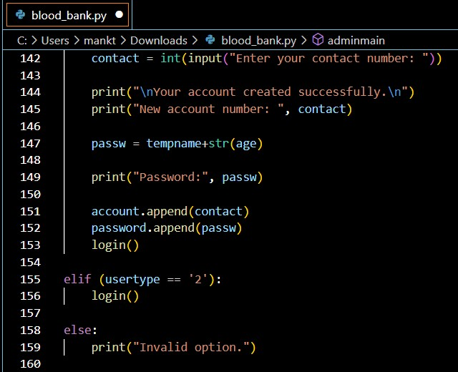

Slide 8
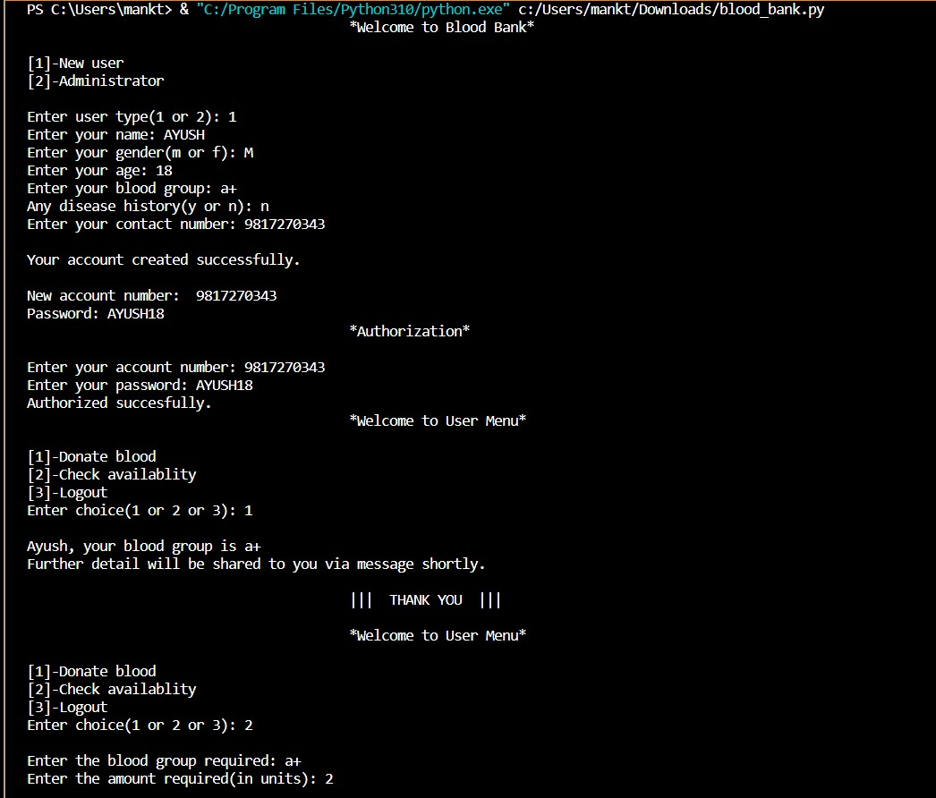
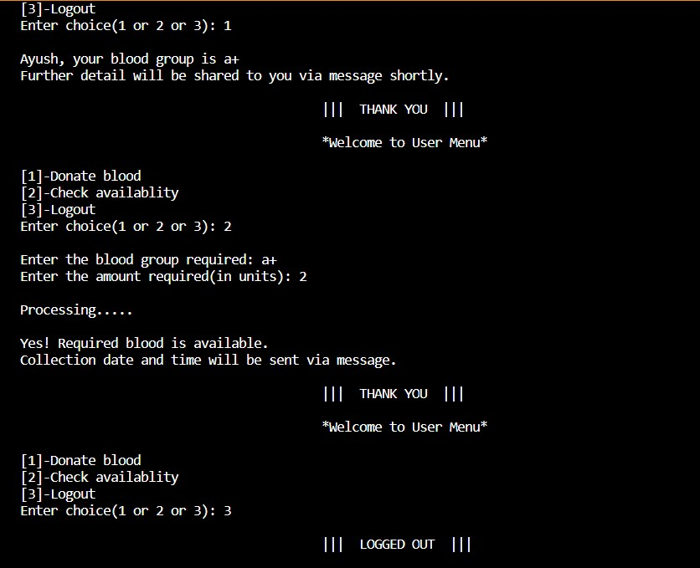
INPUT IN TERMINAL : for new user

Slide 9
future scope :
In Future we will create an GUI.
We will try to make a navigation based system through which user can check the availability of required blood in the nearest blood bank.
We will try to add delivery services and tracking options ,so that blood can be provided to the patients who are in urgent need of it.
We will try to collaborate with hospitals all over India so that more blood banks can be connected to each other, which will further help in collecting and providing required blood in the shortest possible time.

Slide 10


Slide 11
WORK ALLOTMENT :
PROJECT CREATED BY : ROLE ALLOTMENT:
1. Ayush Kumar Gupta 1. Idea behind project and
[Roll no. 2210991425] designing.
2. Ayush 2. Code creation and
[Roll no. 2210991418] designing.
3. Ashutosh Rana. 3.Logic building and code
[ Roll no. 2210991409] creation
PROJECT GUIDED BY:
Mrs. Rishu Taneja

